Slide 1
contents
1.Firewall
2.Type of firewall
3.How does firewall network work

Slide 2

What Is A firewall?
is a network security device that monitors incoming and outgoing network traffic and decides whether to allow or block specific traffic based on a defined set of security rules .Firewalls have been a first line of defense in network security for over 25 years. They establish a barrier between secured and controlled internal networks that can be trusted and untrusted outside networks, such as the Internet.

Slide 3
Types of Firewalls
Packet Filtering firewall:
A packet filtering firewall controls data flow to and from a network. It allows or blocks the data transfer based on the packet's source address, the destination address of the packet, the application protocols to transfer the data, and so on.
2. Proxy Service Firewall: This type of firewall protects the network by filtering messages at the application layer. For a specific application, a proxy firewall serves as the gateway from one network to another.
3. Stateful Inspection Reference: Such a firewall permits or blocks network traffic based on state, port, and protocol. Here, it decides filtering based on administrator-defined rules and context.

Slide 4
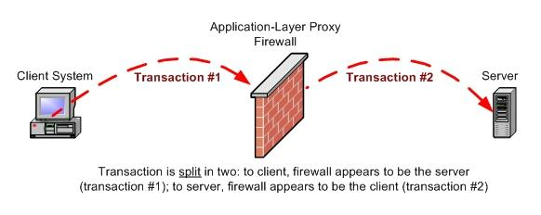
4. Application Layer Firewalls :These firewall scan examine application layer (of OSI model) information like an HTTP request. If finds some suspicious application that can be responsible for harming our network or that is not safe for our network then it gets blocked right away.

Slide 5
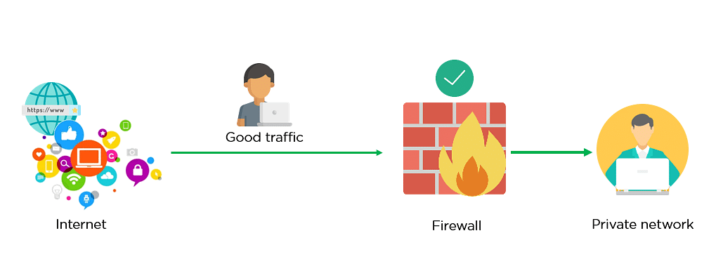
How Does a Firewall Work?

Slide 6
Advantages of Using Firewall
• Firewalls play an important role in the companies for security management. Below are some of the important advantages of using firewalls.
• It provides enhanced security and privacy from vulnerable services. It prevents unauthorized users from accessing a private network that is connected to the internet.
• Firewalls provide faster response time and can handle more traffic loads.
• A firewall allows you to easily handle and update the security protocols from a single authorized device.
• It safeguards your network from phishing attacks.

Slide 7
How to Use Firewall Protection?
To keep your network and devices safe, make sure your firewall is set up and maintained correctly. Here are some tips to help you improve your firewall security:
• Constantly update your firewalls as soon as possible: Firmware patches keep your firewall updated against any newly discovered vulnerabilities.
• Use antivirus protection: In addition to firewalls, you need to use antivirus software to protect your system from viruses and other infections.
• Limit accessible ports and host: Limit inbound and outbound connections to a strict whitelist of trusted IP addresses.
• Have active network: To avoid downtime, have active network QUALITY. Data backups for network hosts and other critical systems can help you avoid data loss and lost productivity in the case of a disaster

Slide 8
THANK YOU

